Slide 1
From Harrison
to GPS

Slide 2
1707 Naval disaster

Slide 3
John Harrison

Slide 4
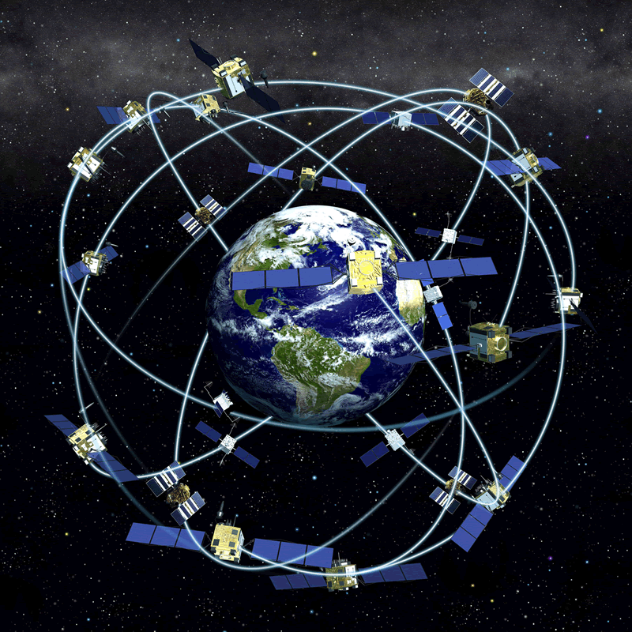

Slide 6
Notes:
Source http://www.freqelec.com/gps_gnss/gps_basics-gnss_future_10-08.pdf

Slide 7
US Pre-GPS Space Based Navigation Proposals:
A) Angle
1) Edward Everett Hale, The Brick Moon, 1869
B) Doppler
1) Lovell Lawrence, Jr., "Navigation by Satellites", Missiles and Rockets, 1956
2) Transit - George Weiffenbach and William Guier, Applied Physics Laboratory - 1958
C) Range Measurement
1) TIMATION - Naval Research Laboratory - Roger Easton - 1964
2) Roy Anderson - GE/NASA – 1964
3) 621B - Air Force/Aerospace - 1964
4) SECOR -SEquential COllation of Range - Army

Slide 8
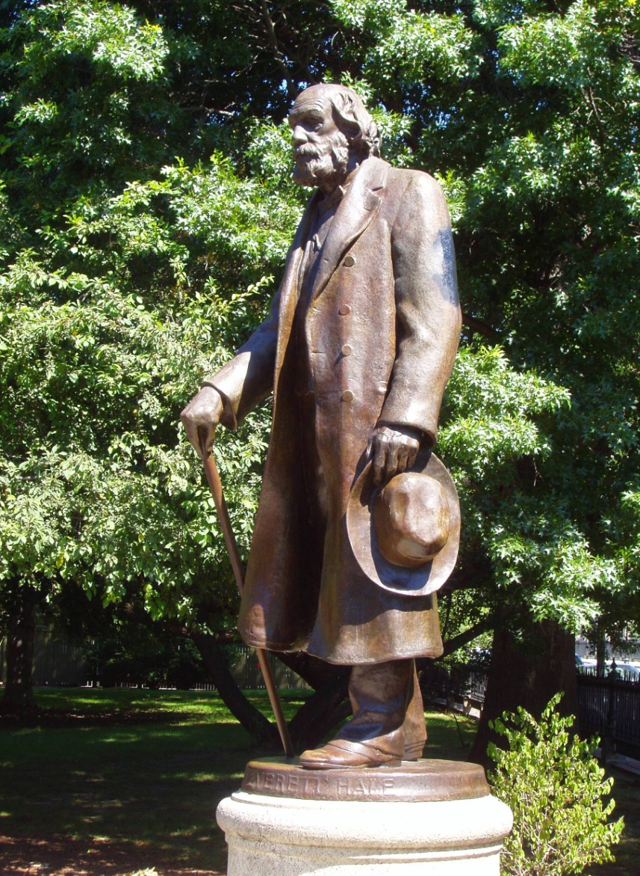
Edward Everett Hale

Slide 9
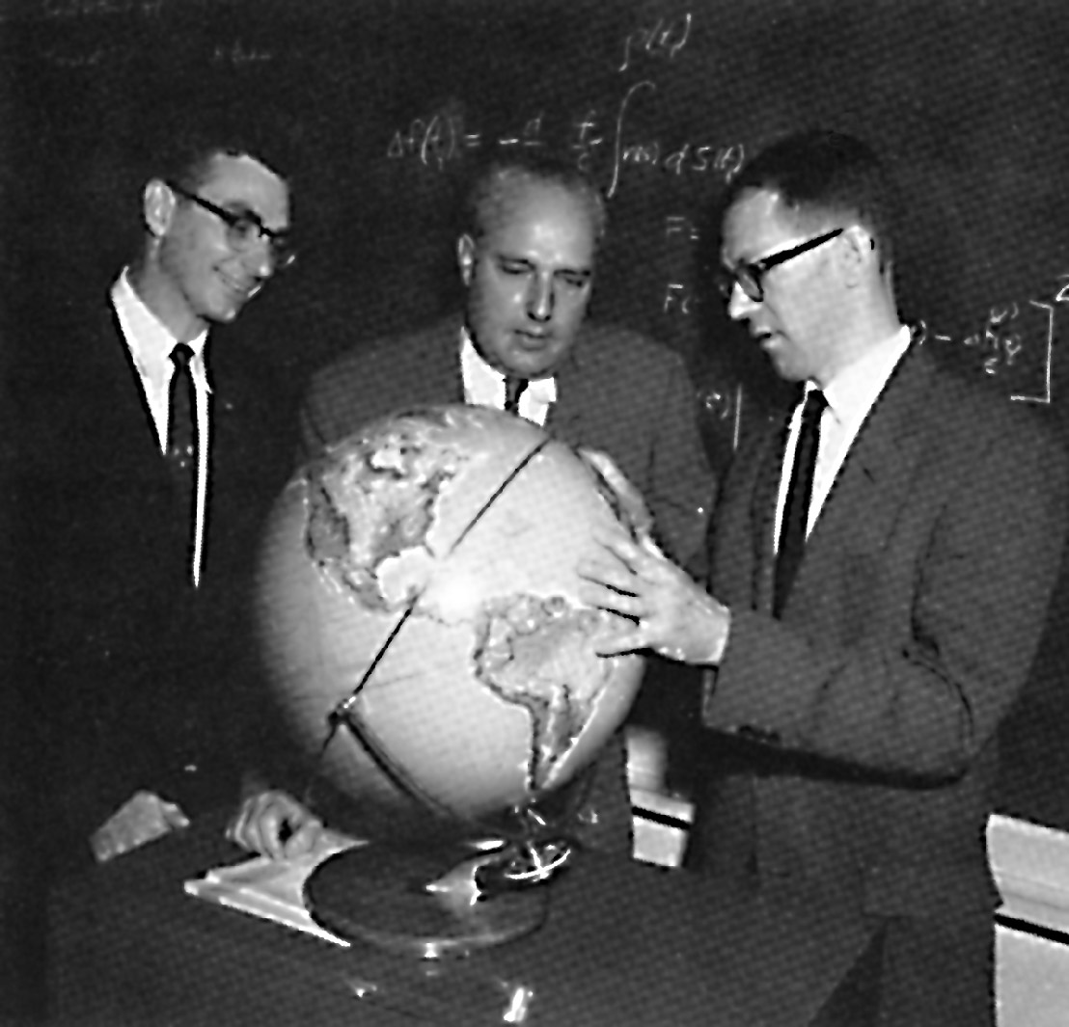
Guier, McClure and Weiffenbach

Slide 10
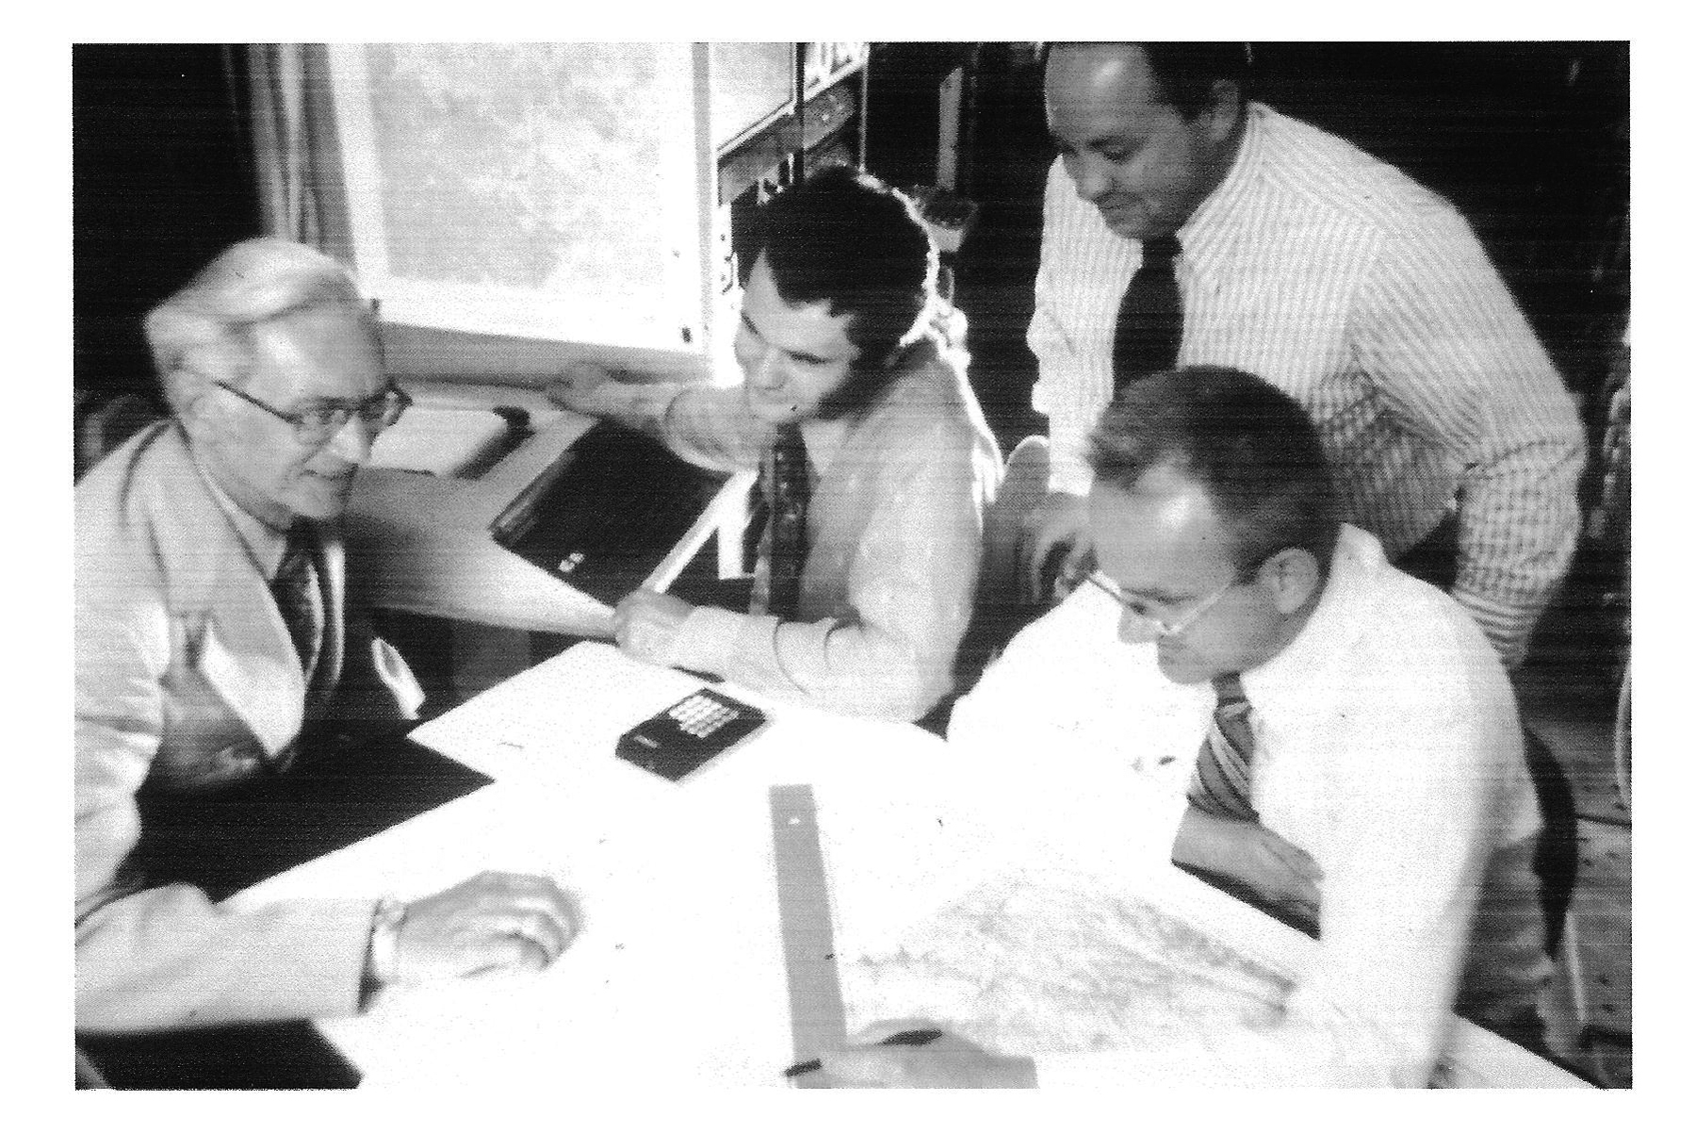
Roy Anderson
Notes:
Roy Anderson on left

Slide 12
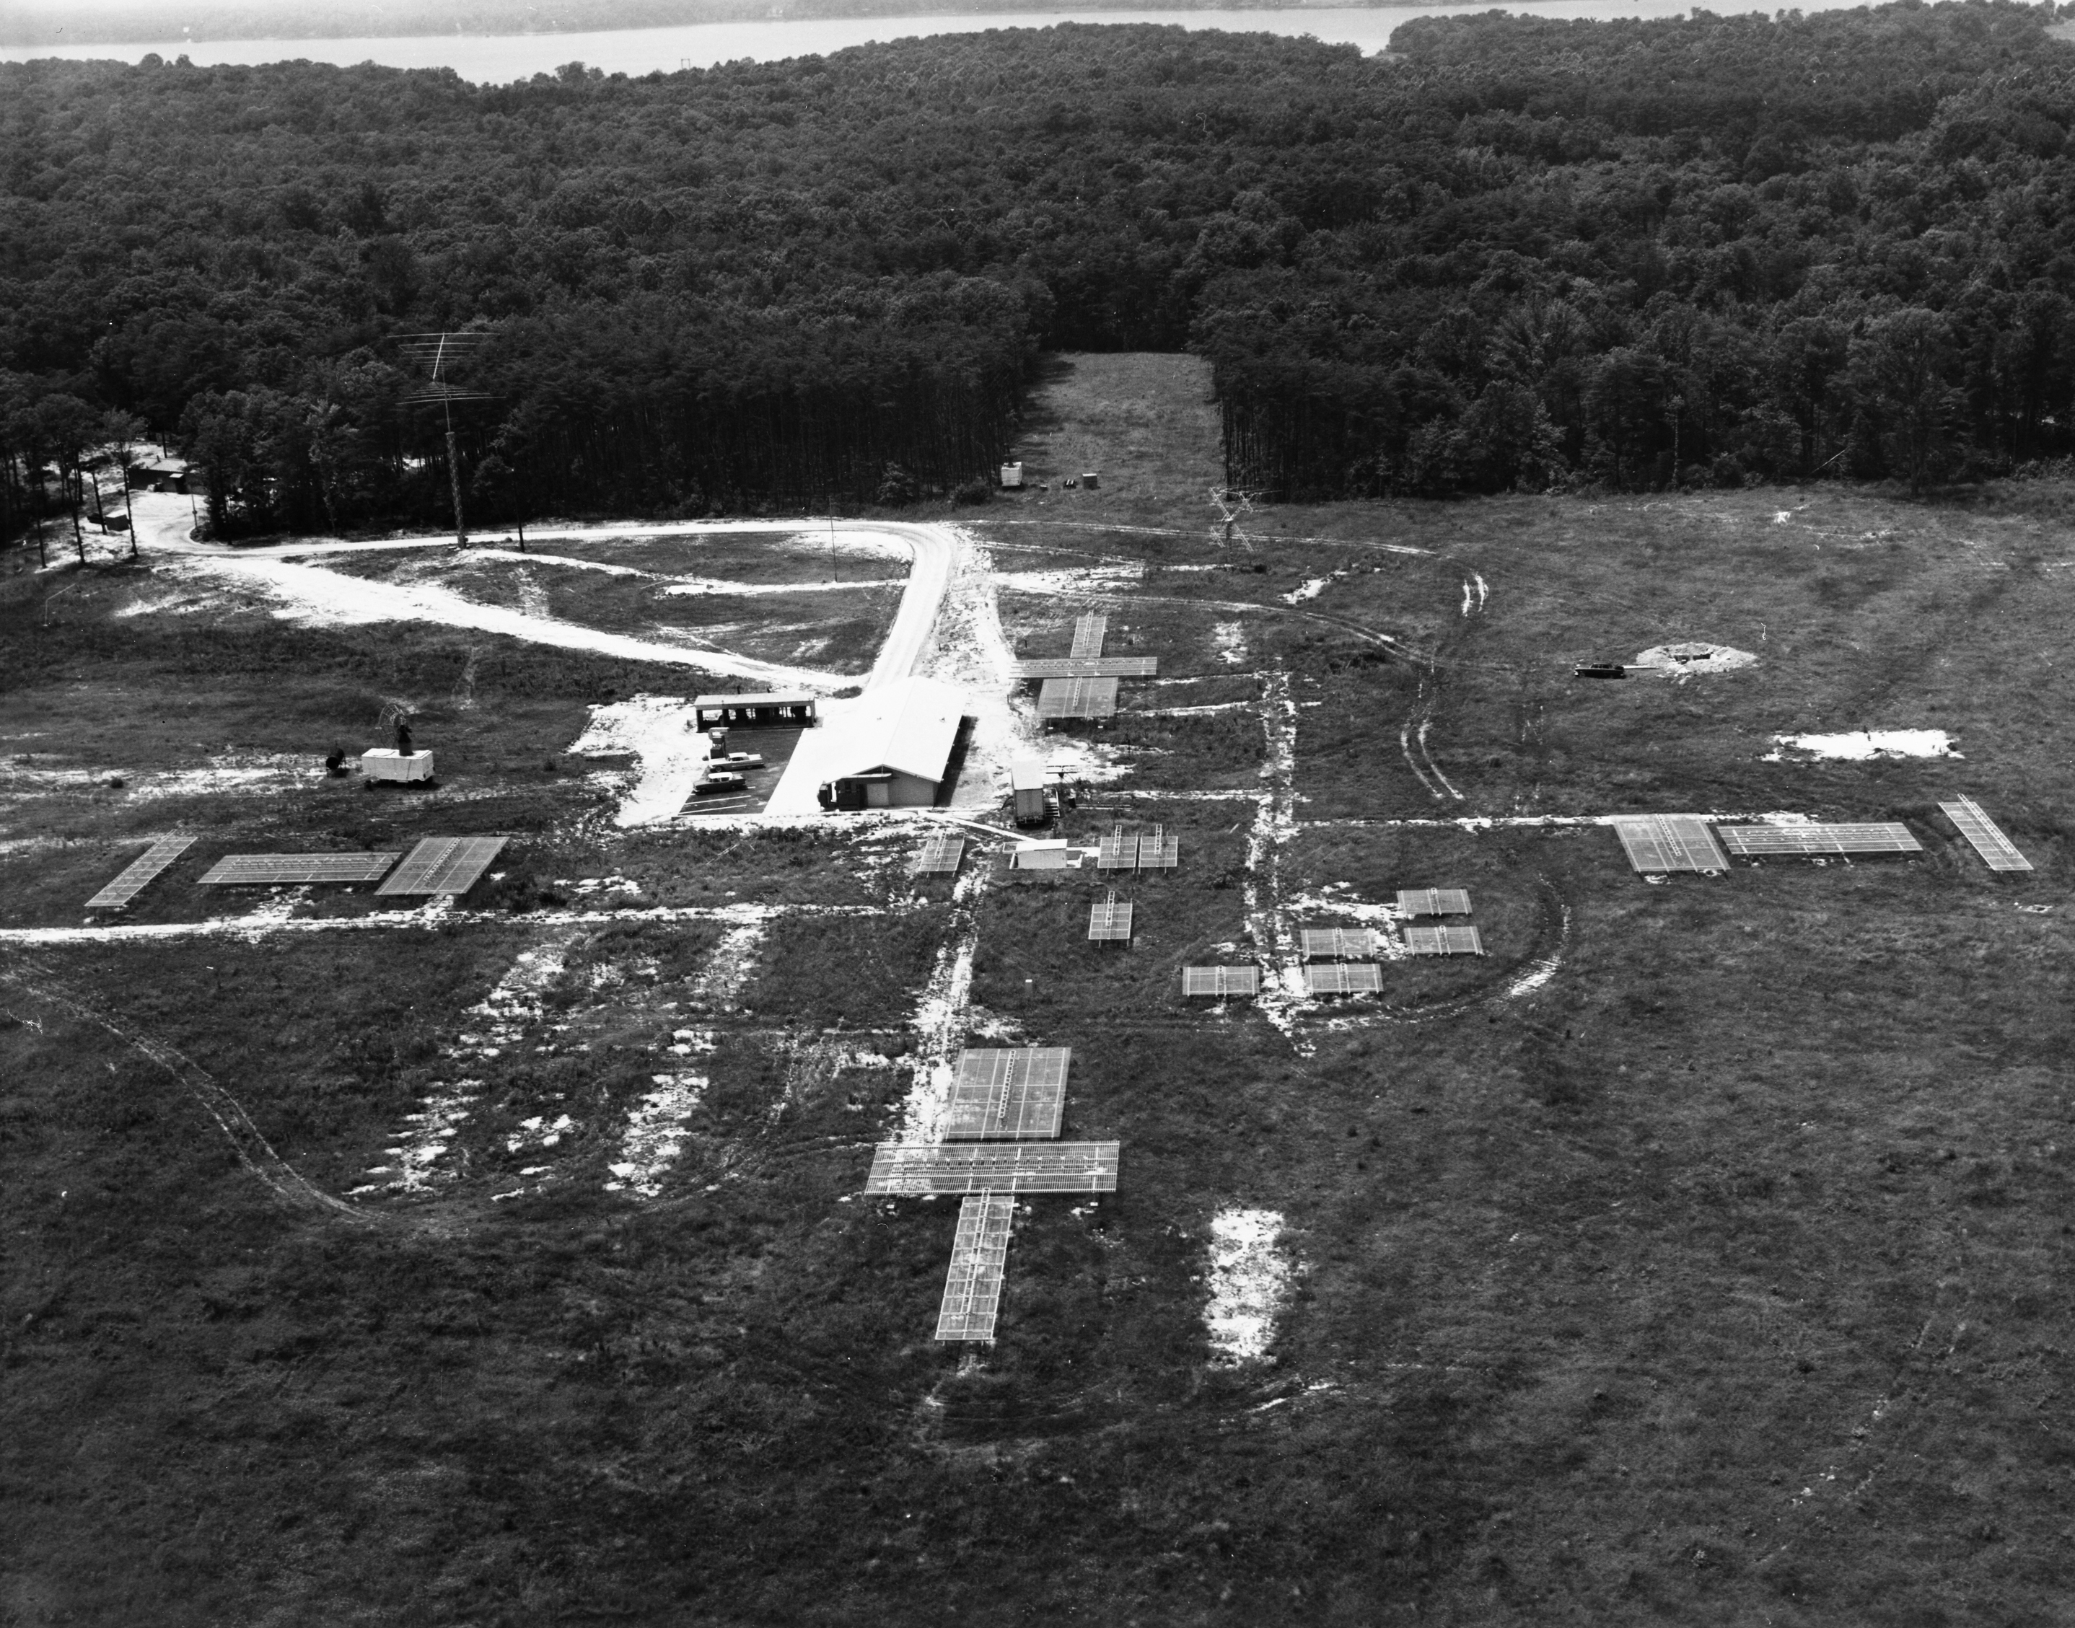
Notes:
Blossom Point station 1958

Slide 13
Vanguard TV-3 explodes

Slide 14
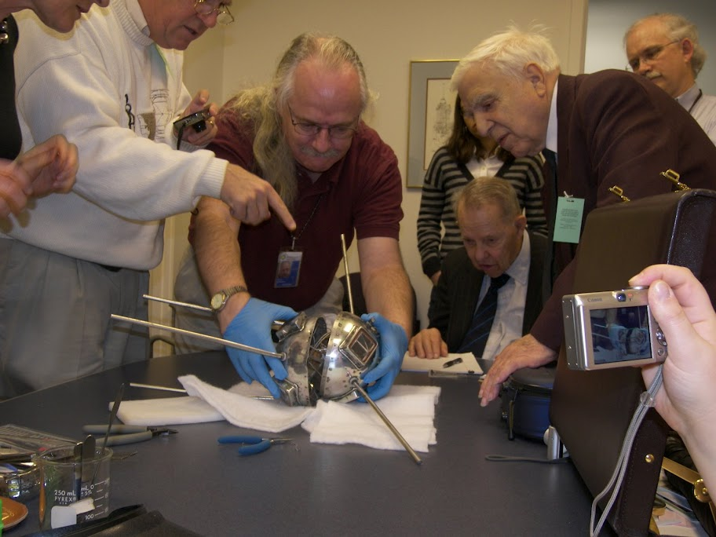
Notes:
Pulling apart the halves: Hanna Szczepanowska, Chris Hagen, David Devorkin, Martin Votaw, Megan Nelson (behind), Roger Easton, Michael Neufeld

Slide 15
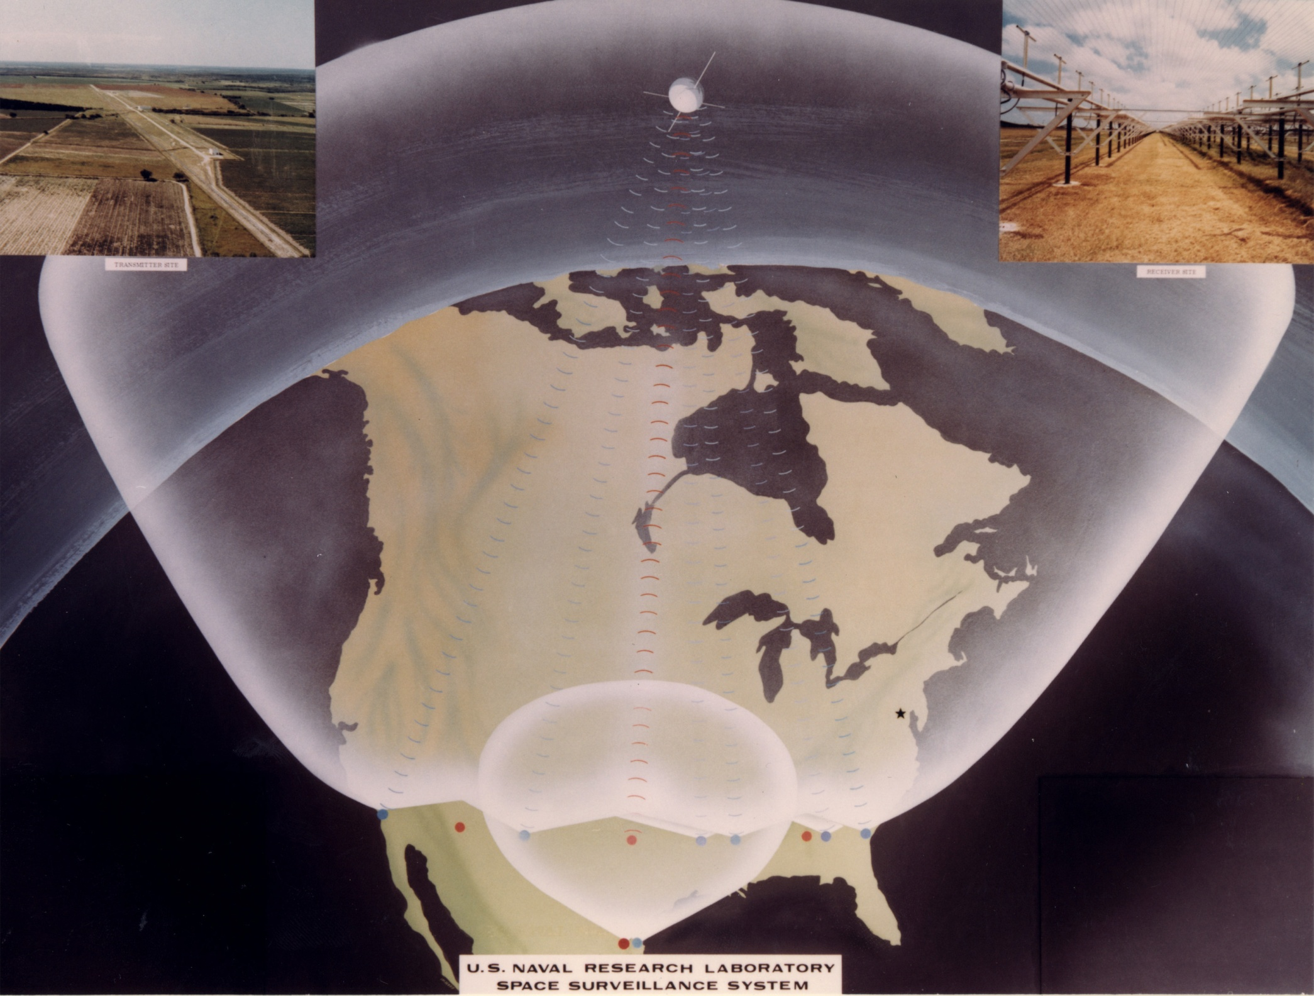

Slide 16
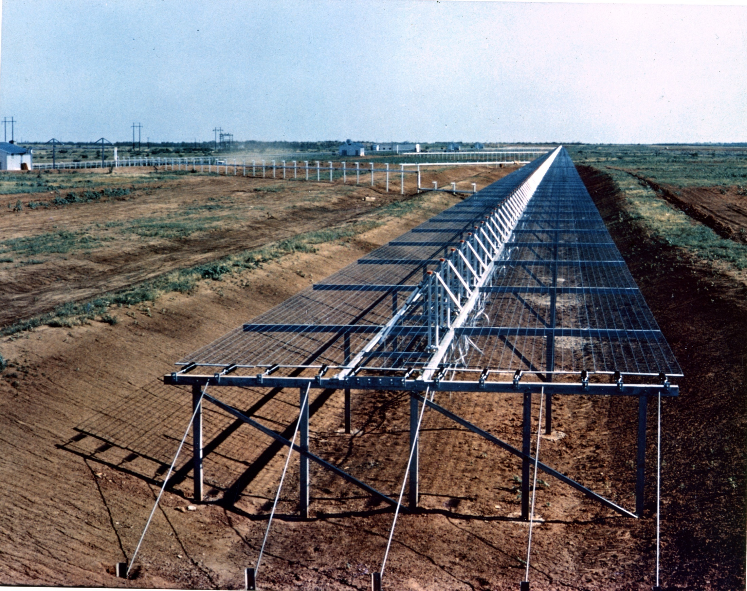
Notes:
Lake Kickapoo Texas Tracking Station Transmitter

Slide 17
1967 Chronology

Slide 18
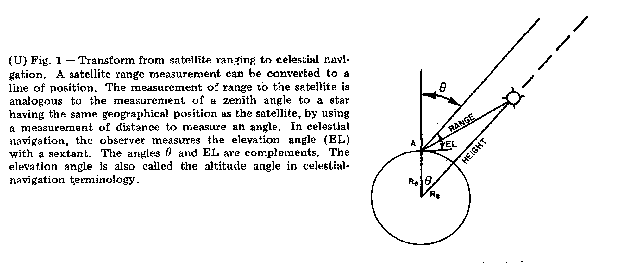
Celestial Transformation

Slide 19
Notes:
621B chronology

Slide 20
Brad Parkinson

Slide 22
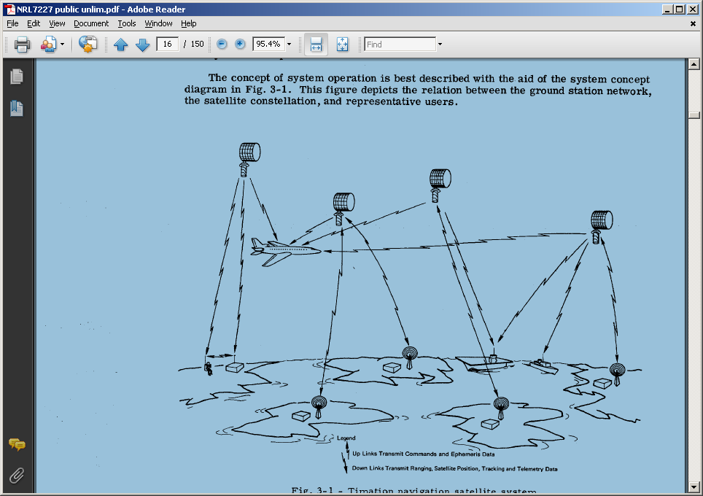
Notes:
Timation Development Plan March 1971

Slide 23
GNSS Systems
1) GPS – US
2) GLONASS (Global Navigation Satellite System)– Soviet Union/Russia
3) Galileo – Europe
4) Compass/BeiDou Navigation Satellite System - China
5) Japan
6) India

